Slide 1
Version Control with Git

Slide 2
Installation
Windows: https://git-scm.com/download/win
Mac: https://git-scm.com/download/mac/
Linux (Debian/Ubuntu):
apt-get install git-core gitk
Linux (Fedora):
yum install git gitk

Slide 3
Verify installation
Windows: Open "Git Bash"
Mac/Linux: Open your terminal To verify, run:
$ git --version

Slide 4
Yes, we are going to use the command line today
Feel free to use graphical interfaces after you learn the basics.

Slide 5
Initial Setup
$ git | config | --global | user.name | "Your Name"
$ git | config | --global | user.email | "your_email@whatever.com"
Windows:
$ git | config | --global | core.autocrlf | true
$ git | config | --global | core.safecrlf | true
Linux/Mac:
$ git | config | --global | core.autocrlf | input
$ git | config | --global | core.safecrlf | true

Slide 6
Version Control

Slide 7
Version Control
aka Revision Control

Slide 8
Version Control
aka Revision Control
aka How we do things in the Real World

Slide 9
Sharing Code

Slide 10
Working as a Team

Slide 11


Slide 12
Version Control

Slide 13
Why Version Control?

Slide 14
Reason #1:
"Versioning"

Slide 15
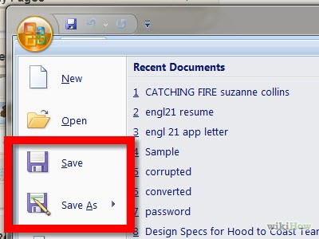

Slide 16
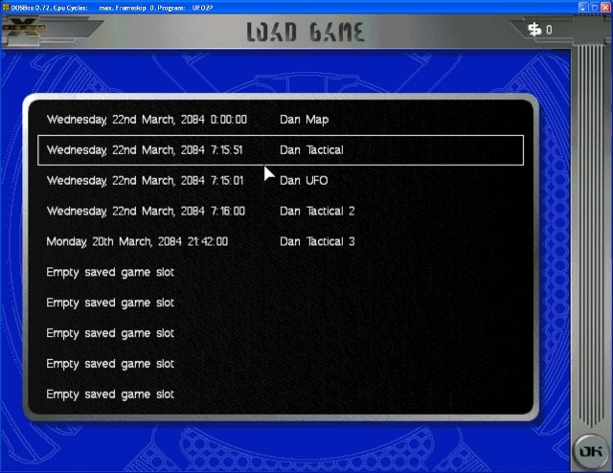

Slide 17
Wait a minute...

Slide 18
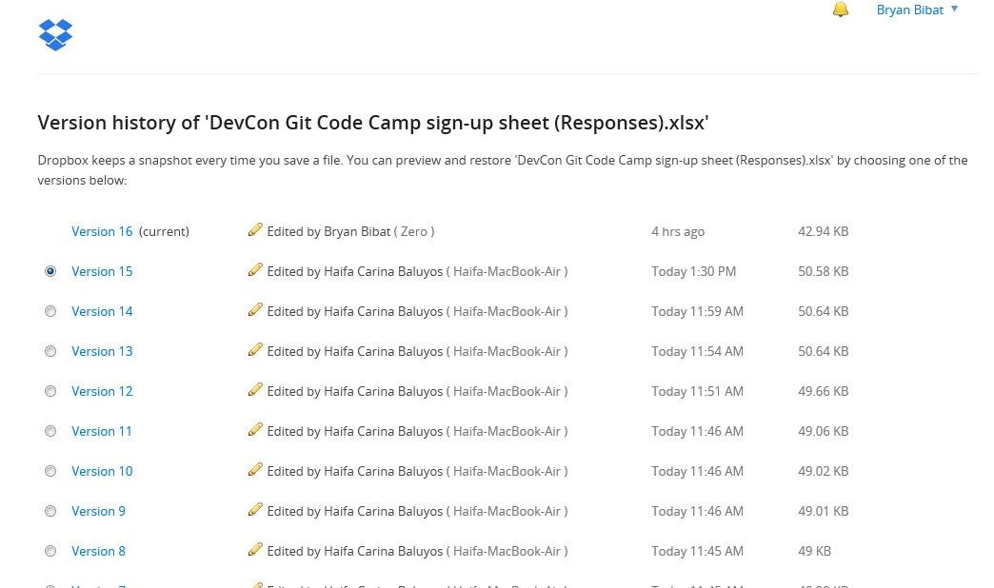

Slide 19
Finer-grained Control

Slide 20
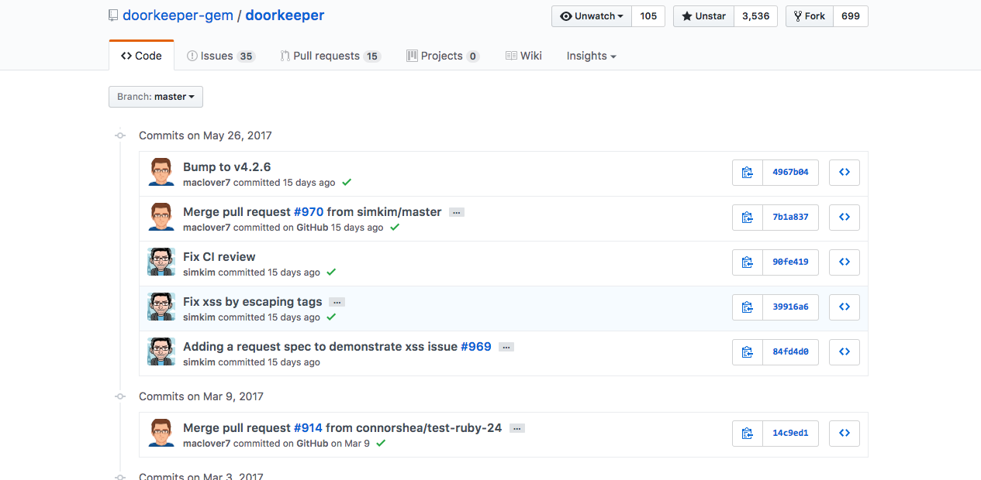

Slide 21
Enough talk. Let's begin...

Slide 22
Create your first repository
$ mkdir dct-git101
$ cd dct-git101
$ git init

Slide 23
Create your first repository
$ mkdir dct-git101
$ cd dct-git101
$ git init

Slide 24
Create your first repository
$ mkdir dct-git101
$ cd dct-git101
$ git init
Here we create a project folder

Slide 25
Create your first repository
$ mkdir devcon-git101
$ cd devcon-git101
$ git init
… Then we initialize it as a git repository.

Slide 26
Create your first repository
$ mkdir devcon-git101
$ cd devcon-git101
$ git init
… Then we initialize it as a git repository.
Git can now track the changes inside our project folder.

Slide 27
Create your first commit
First create a file "hello.txt" containing:
Hello
Then run the following commands:
$ git add hello.txt
$ git commit -m "Initial Commit"

Slide 28
View the repository history
$ git log
(press q to exit)

Slide 29
View the pretty repo history
$ git log --graph --pretty=oneline
(press q to exit)

Slide 30
Ah, what the hell...
Windows/Linux:
$ gitk / gitx
Mac:
$ gitk

Slide 31
Create your second commit
Modify "hello.txt" to add "world":
Hello World!
Then run the following commands:
$ git add hello.txt
$ git commit -m "Make hello.txt more exciting"

Slide 32
View the updated history
Windows/Linux:
$ gitk
Mac:
$ gitx

Slide 33
What just happened?

Slide 34

http://git-scm.com/book/en/Getting-Started-Git-Basics

Slide 35
git add
git commit
http://git-scm.com/book/en/Getting-Started-Git-Basics

Slide 36
6fba518
Initial Commit

Slide 37
6fba518
Initial Commit
object name
aka object id, commit hash
SHA-1 hash / checksum for verifying the integrity of the contents of the commit Calculated based on file contents and metadata like last updated date i.e. yours will be different
●
●

Slide 38
e642771
Make hello.txt more exciting
6fba518
Initial Commit

Slide 39
e642771
Make hello.txt more exciting
No, this is not a mistake; commits refer to their parent(s), not the other way around.
6fba518
Initial Commit

Slide 40
Commit multiple files
Create a file "names.txt" containing:
Alice Bob Cindy

Slide 41
Commit multiple files
Create a file "numbers.txt" containing:
3
9
16
12
8.2
4

Slide 42
Commit multiple files
Run the following commands:
$ git add names.txt numbers.txt
$ git commit -m "Create 2 files in a single commit"

Slide 43
e642771
Make hello.txt more exciting
6fba518
Initial Commit

Slide 44
Each commit deals with a set of files
7c57165
Create 2 files in a single commit
2 files created
e642771
Make hello.txt more exciting
1 file modified
6fba518
Initial Commit
1 file created

Slide 45
We've covered "Save", but before we move on to "Load"...

Slide 46
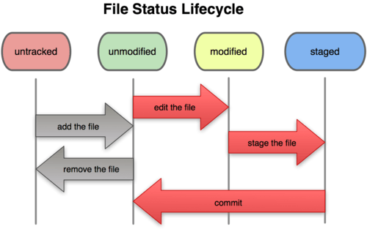
http://git-scm.com/book/en/Git-Basics-Recording-Changes-to-the-Repository

Slide 47
File Status
(all unmodified)
$ git status
# On branch master
nothing to commit, working directory clean

Slide 48
File Status
(untracked)
Create a file "animals.txt" containing:
Dogs Cats Mice

Slide 49
File Status
(untracked)
$ git status
# On branch master
# Untracked files:
# (use "git add <file>..." to include in what will be committed)
#
# animals.txt
nothing added to commit but untracked files present (use "git add" to track)

Slide 50
File Status
(untracked and modified)
Modify "names.txt" to add "Janet":
Alice Bob Janet Cindy

Slide 51
File Status
(untracked and modified)
$ git status
# On branch master
# Changes not staged for commit:
# (use "git add <file>..." to update what will be committed)
# (use "git checkout -- <file>..." to discard changes in working
directory)
#
# modified:
#
# Untracked files:
names.txt
# (use "git add <file>..." to include in what will be committed)
#
#
animals.txt
no changes added to commit (use "git add" and/or "git commit -a")

Slide 52
File Status
(untracked and staged)
$ git add names.txt
$ git status
# On branch master
# Changes to be committed:
# (use "git reset HEAD <file>..." to unstage)
#
# modified: names.txt
#
# Untracked files:
# (use "git add <file>..." to include in what will be committed)
#
#
animals.txt

Slide 53
File Status
(commit staged)
$ git commit -m "Add Janet" [master 5e545ed] Add Janet
1 file changed, 1 insertion(+)
$ git status
# On branch master
# Untracked files:
# (use "git add <file>..." to include in what will be committed)
#
#
animals.txt

Slide 54
Shortcuts

Slide 55
Stage a folder
Modify "names.txt" to add "Ramon":
Alice Ramon Bob Janet Cindy

Slide 56
Stage a folder
$ git add .
$ git status
# On branch master
# Changes to be committed:
# (use "git reset HEAD <file>..." to unstage)
#
#
#
#
new file: modified:
animals.txt names.txt

Slide 57
Unstage a file
$ git reset HEAD names.txt Unstaged changes after reset: M names.txt
$ git status
# On branch master
# Changes to be committed:
# (use "git reset HEAD <file>..." to unstage)
#
# new file: animals.txt
#
# Changes not staged for commit:
# (use "git add <file>..." to update what will be committed)
# (use "git checkout -- <file>..." to discard changes in working directory)
#
#
#
modified:
names.txt

Slide 58
Unmodify a file
$ git checkout -- names.txt
$ git status
# On branch master
# Changes to be committed:
# (use "git reset HEAD <file>..." to unstage)
#
# new file: animals.txt
#

Slide 59
do it again...
Modify "names.txt" to add "Ramon":
Alice Ramon Bob Janet Cindy

Slide 60
Stage and commit EVERYTHING
(except untracked files)
$ git commit -a -m "Commit unrelated changes.. DON'T DO THIS" [master 61f1cd8] Commit unrelated changes.. DON'T DO THIS
2 files changed, 4 insertions(+)
create mode 100644 animals.txt
$ git status
# On branch master
nothing to commit, working directory clean
Note: using "-a" will also stage moved and renamed files.

Slide 61
View history
$ git log | --graph --pretty=format:'%h %s%d' | --all
* 7c57165 | Create 2 files in a single commit | (HEAD, master)
* e642771 | Make hello.txt more exciting
* 6fba518 | Initial Commit
or
$ gitk --all

Slide 62
Unreferenced commits will not show up in the history.
Coincidentally, we can use Tags to refer to a commit.

Slide 63
View history
$ git log --graph --pretty=format:'%h %s%d' --all
2a1b52e Revert "Commit unrelated changes... DON'T DO THIS" (tagging-demo)
3a0eac3 Commit unrelated changes... DON'T DO THIS
5e545ed Add Janet
7c57165 Create 2 files in a single commit (HEAD, master)
e642771 Make hello.txt more exciting
6fba518 Initial Commit
or
$ gitk --all

Slide 64
Best Practices

Slide 65
Write good commit messages
You should be able to get an idea what changed and why just by looking at the commit messages

Slide 66
Commit related changes
This would make it easier to roll back changes

Slide 67
Commit often

Slide 68
Do not commit generated files
E.g. compiled bytecode or executables, log files, temporary files, etc.

Slide 69
Do not commit sensitive information
E.g. passwords, settings.
You can, however, commit templates.

Slide 70
Helpful Stuff
that we will not explain in detail...

Slide 71
.gitignore
https://github.com/github/gitignore

Slide 72
git stash

Slide 73
git blame

Slide 74
Summary of Commands
git init - initialize repository
git add - add files/folders to staging git commit - commit files in staging git status - view status of repository
git log / gitk - view history of repository
git revert - unstage files
git reset - move HEAD to another commit
git tag - tag a commit

Slide 75
Summary of Command Variations
git commit -a
auto-stage all deleted, moved, modified
gitk --all / git log --all
include all branches, tags
git tag -d
delete tag

Slide 76
Why Version Control?

Slide 77
Reason #2:
Backup

Slide 78
Reason #2:
Backup

Slide 79
Reason #2:
Collaboration

Slide 80
If we were pressed for time...
Register at GitHub
Learn git clone
Learn git push / git pull
Learn how to fix merge conflicts

Slide 81
...but we're not, so let's first discuss something that will help us later on.

Slide 82
Branching

Slide 83
File Status
(all unmodified)
$ git status
# On branch master
nothing to commit, working directory clean

Slide 84
File Status
(all unmodified)
$ git status
# On branch master
nothing to commit, working directory clean

Slide 85
Create a branch
$ git branch testing

Slide 86
Switch to branch
$ git checkout testing Switched to branch 'testing'
$ git status
# On branch testing
nothing to commit, working directory clean

Slide 87
Commit to new branch
Modify "names.txt" to add "Eve":
Alice Bob Cindy Eve

Slide 88
Commit to new branch
$ git commit -am "Add Eve" [testing cdd47c2] Add Eve
1 file changed, 1 insertion(+)
$ gitk

Slide 89
Switch back to master
$ git checkout master Switched to branch 'master'

Slide 90
Difference between log --all vs normal log
$ gitk

Slide 91
Difference between log --all vs normal log
$ gitk --all

Slide 92
Commit to master
Modify "names.txt" to add "Billy":
Alice Billy Bob Cindy
$ git commit -am "Add Billy" [master cc3044c] Add Billy
1 file changed, 1 insertion(+)

Slide 93
Shortcut: create and switch
$ git checkout -b testing2 Switched to branch 'testing2'

Slide 94
Commit to testing2
Modify "names.txt" to add "Dave":
Alice Billy Bob Cindy Dave
$ git commit -am "Add Dave" [testing2 80414cf] Add Dave
1 file changed, 1 insertion(+)

Slide 95
Go back to master
$ git checkout master Switched to branch 'master'
$ gitk --all

Slide 96
Merge another branch
$ git merge testing Auto-merging names.txt
Merge made by the 'recursive' strategy. names.txt | 1 +
1 file changed, 1 insertion(+)

Slide 97

yay, we learned something!

Slide 98
We are almost to Github… but first…

Slide 99
Remote Repositories

Slide 100
Clone into another folder
$ cd ..
$ git clone dct-git101 git101 Cloning into 'git101'...
done.

Slide 101
Check the clone repo
$ cd git101
$ gitk

Slide 102
Show remote repos
$ git remote origin

Slide 103
"origin" remote repo
(default repo referring to the repo's origin)
$ git remote show origin
* remote origin
Fetch URL: /Users/aniketrao/dct-git101 Push URL: /Users/aniketrao/dct-git101 HEAD branch: master
Remote branches: master tracked merging-demo tracked
testing testing2
tracked tracked
Local branch configured for 'git pull': master merges with remote master
Local ref configured for 'git push': master pushes to master (up to date)

Slide 104
Fetching demo
Go back to git101 and fetch the changes:
$ cd ../git101
$ git fetch
remote: Counting objects: 5, done.
remote: Compressing objects: 100% (2/2), done. remote: Total 3 (delta 0), reused 0 (delta 0) Unpacking objects: 100% (3/3), done.
From /Users/aniketrao/dct-git101 73dd819..cf5f902 master -> origin/master

Slide 105
Merge the fetched branch
$ git merge origin/master Updating 73dd819..cf5f902 Fast-forward
names.txt | 1 +
1 file changed, 1 insertion(+)

Slide 106
Shortcut
$ git fetch
$ git merge origin/master
is equivalent to
$ git pull
if you're in master branch.
We'll discuss more of this later.

Slide 107
Now that we understand the basic idea behind remote repos, let's proceed to Github...
Sign-up at https://github.com

Slide 108
There are multiple ways to authenticate users in Git.
We'll discuss the most secure one: via SSH keys.

Slide 109
Cryptography pasakalye...

Slide 110
Authentication via Password
Client
Server

Slide 111
Authentication via Password
username + password
Client sends credentials
Server verifies
password DB

Slide 112
Authentication via Password
username + password
Client sends credentials
Server verifies
can be intercepted
e.g. FTP
password DB

Slide 113


Authentication via SSH Key
(oversimplified)
Client has 2 "keys"
private key public key
Server

Slide 114

Authentication via SSH Key
(oversimplified)
Client has 2 "keys"
private key public key
Server has a list of authorized keys

Slide 115
Authentication via SSH Key
(oversimplified)
First, the public key must be sent to the server securely beforehand.
Client has 2 "keys"
Server has a list of authorized keys
private key public key

Slide 116
Authentication via SSH Key
(oversimplified)
Using the private key, client can create a package that can only be unlocked by the corresponding public key and only that public key.
Client
Server has a list of authorized keys
private key public key

Slide 117

Authentication via SSH Key
(oversimplified)
Using the private key, client can create a package that can only be unlocked by the corresponding public key and only that public key.
Client
Server has a list of authorized keys
private key public key

Slide 118
Authentication via SSH Key
(oversimplified)
Using the private key, client can create a package that can only be unlocked by the corresponding public key and only that public key.
Client
Server has a list of authorized keys
private key public key

Slide 119

Authentication via SSH Key
(oversimplified)
Using the private key, client can create a package that can only be unlocked by the corresponding public key and only that public key.
Client
Server has a list of authorized keys
doesn't matter if intercepted since they still need to crack it.
private key public key

Slide 120
How to generate your SSH Keys:
https://help.github.com/articles/generating-ssh-keys
Also, follow the steps to add your public key to Github.

Slide 121
If you want to be secure, use a passphrase.
However, if you're using Windows, you will need to enter it every time you run a git command that connects to Github.

Slide 122
Fortunately, there is a workaround that will only require you to enter it once per session.
http://stackoverflow.com/a/9011152

Slide 123
Create a repo in Github for
dct-git101
https://github.com/new

Slide 124
Pushing dct-git101
Go back to dct-git101 and push it to your new repo (use SSH url)
$ git remote add origin git@github.com:user/dct-git101.git
$ git push -u origin master
Warning: Permanently added the RSA host key for IP address '192.30.252.130' to the list of known hosts.
Enter passphrase for key '/Users/aniketrao/.ssh/id_rsa': Counting objects: 40, done.
Delta compression using up to 4 threads. Compressing objects: 100% (24/24), done. Writing objects: 100% (40/40), 3.41 KiB, done. Total 40 (delta 3), reused 0 (delta 0)
To git@github.com:user/devcon-git101.git
* [new branch] master -> master
Branch master set up to track remote branch master from origin.

Slide 125
git push
Note that "git push" only pushes a single branch.
If you want to push all branches you can use:
$ git push REMOTE --all
If you want to push all tags you can use:
$ git push REMOTE --tags

Slide 126
Clone into another folder
$ cd ..
$ git clone git@github.com:user/dct-git101.git github-git101 Cloning into 'github-git101'...
remote: Counting objects: 40, done.
remote: Compressing objects: 100% (21/21), done. remote: Total 40 (delta 3), reused 40 (delta 3) Receiving objects: 100% (40/40), done.
Resolving deltas: 100% (3/3), done. done.

Slide 127
play time
With the cloned folder, you can now play around with certain collaboration scenarios. For example:
Make some changes in /dct-git101
Commit it via "git commit"
Push it to the repo at Github via "git push"
Go to /github-git101 and pull the changes via "git pull"

Slide 128
Want to let someone else push to your repo?
Go to the repo Settings →
Collaborators and add your friends.

Slide 129
Push/Pull
You'll quickly notice that git push only allows fast-forward changes to be pushed.
In simpler terms, you cannot push until you pull the latest changes from the remote.

Slide 130
pull + rebase
Want to get rid of the distracting merge commits whenever you pull when you have pending commits? Tell git to rebase instead of merging:
$ git pull --rebase origin master

Slide 131
Best Practices

Slide 132
Project Workflow
Here's the most basic workflow for working with with others through version control systems:
Double check if the project work e.g. compiles, pages load, etc.
Stage and commit your changes.
Before pushing, pull changes from the remote project repo. If there are no changes, skip to step 5.
Resolve conflicts, if any, then go back to step 1.
Push your changes.

Slide 133
Communicate!
Version control systems aims to improve communication between team members, not replace it.
Always consult with the other person whenever you encounter a merge conflict.

Slide 134
Broken Builds
To repeat step 1:
1. Double check if the project work e.g. compiles, pages load, etc.
Broken builds are what we call published commits that have obvious critical, show-stopping bugs.
That said, it's better to delay pushing your commits to spend more time making sure that the project works rather than waste everyone's time.

Slide 135
Work in Progress
Avoid publishing half-done work as it can lead to broken builds.
If you need to push those changes (e.g. you want a backup), put them in a branch then push that branch. Or consider using git stash.

Slide 136
Helpful Stuff
that we will still not explain in detail...

Slide 137
Graphical Git Tools

Slide 138
Push
vs
Pull

Slide 139
Backups

Slide 140
GitHub as a Project Management Tool

Slide 141
GitHub as a Project Management Tool for Open Source Projects

Slide 142
GitHub as a Portfolio

Slide 143
Branches + Workflow

Slide 144
Tagging + Deployment

Slide 145
Free Private Repos
Since Github is only free for public repos, you might want to look into the following to keep your source code private:
Assembla (https://www.assembla.com)
1 private repo, limited to 3 collaborators
BitBucket (https://bitbucket.org/)
Unlimited private repos, limited to 5 collaborators
Github Educational Accounts (https://github.com/edu)
free accounts for students and teachers

Slide 146
Summary of Commands
git branch - list, create, or delete branches git checkout - checkout a branch or a path git merge - merge two or more branches
# git rebase - move commits to the end of a branch
git clone - make a local copy of a repository
git remote - list, create, or delete remote repos
git fetch - retrieve objects/changes from a repository
git pull - fetch + merge or rebase
git push - publish local commits to a remote

Slide 147
Summary of Command Variations
git checkout -b
create and checkout branch
git remote add
add a new remote repository to track
git remote rm
remove remote repository
git pull --rebase
rebase instead of merge when pulling

Slide 148
Commands that I use everyday
git | pull
git git | add commit -am "blah | blah"
gitk / git log / git status / git diff git push
git merge branch
git checkout –b new_branch

Slide 149
Commands that I use less often
git clone
git remote add git remote –v
git rebase <branch> / git merge <branch> git checkout -- <path>
git reset --hard <hash> git revert

Slide 150
Thank You For Listening! Slides => https://github.com/anik3tra0/git-basics Github => https://github.com/anik3tra0 Twitter => @aniket_rao

